Slide 1
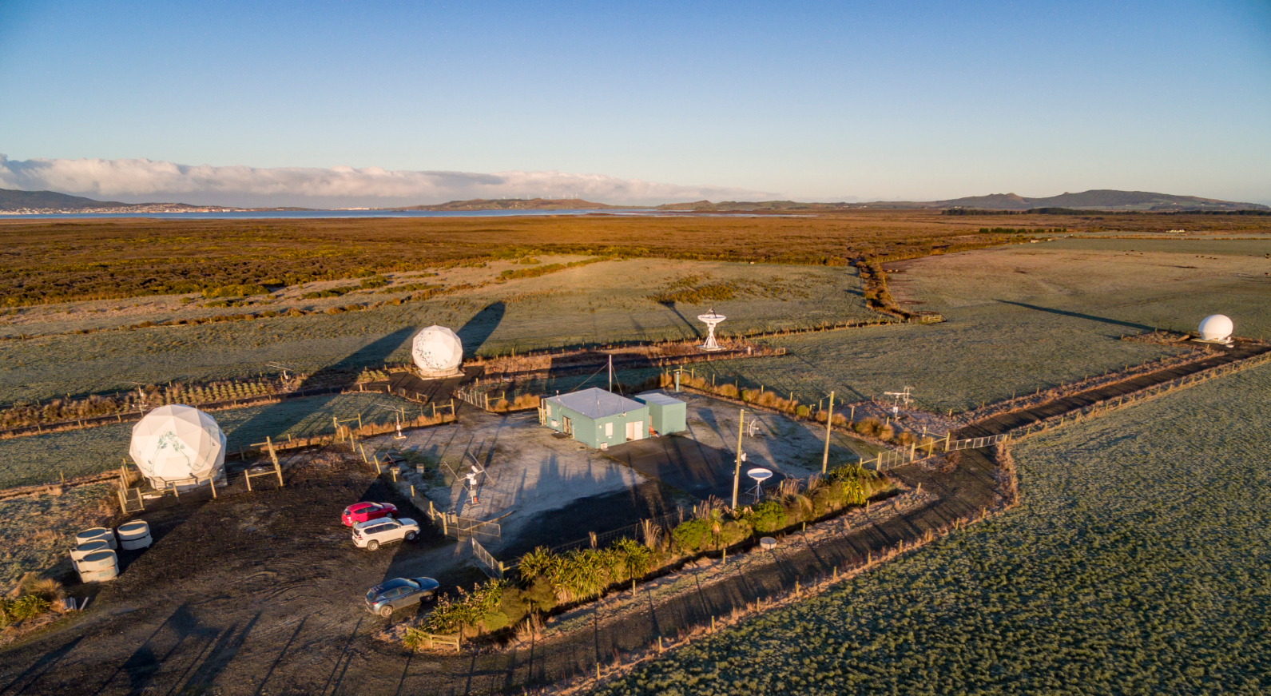
August 2018
Awarua Satellite Ground Station: Antennas & Radomes
781 Colyer Road, Awarua
29 March 2019

Slide 2
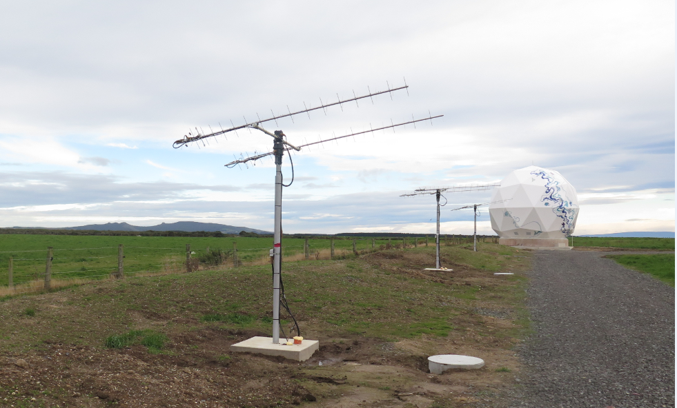
Yagi antenna dimensions
Height of antenna mount: 2.3 m
Length: 3 m
Planet UHF 3m yagi antennas and radome protected 5m dish antenna

Slide 3
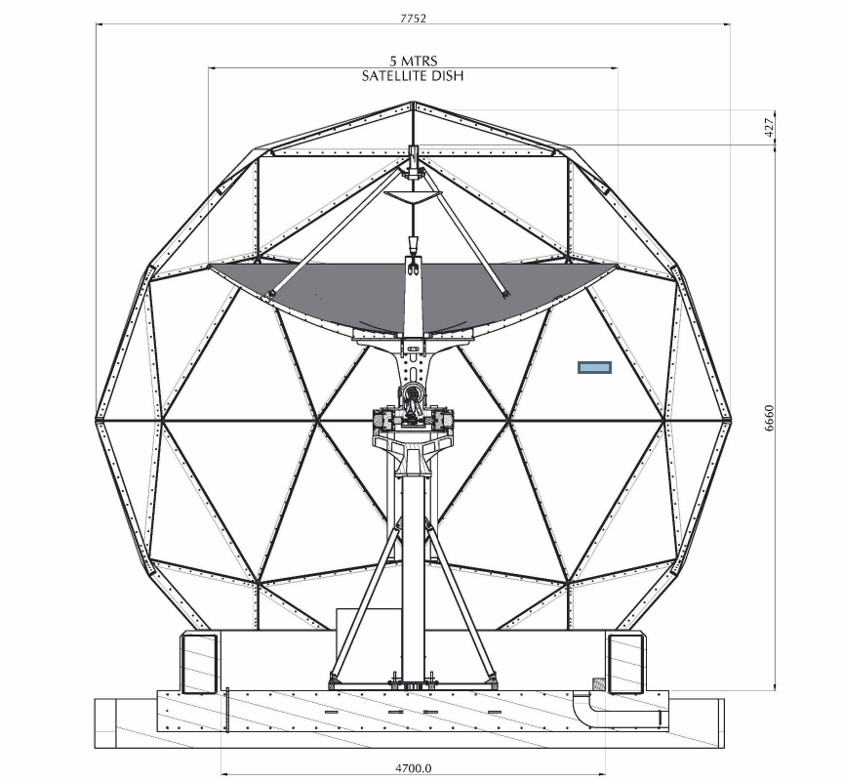
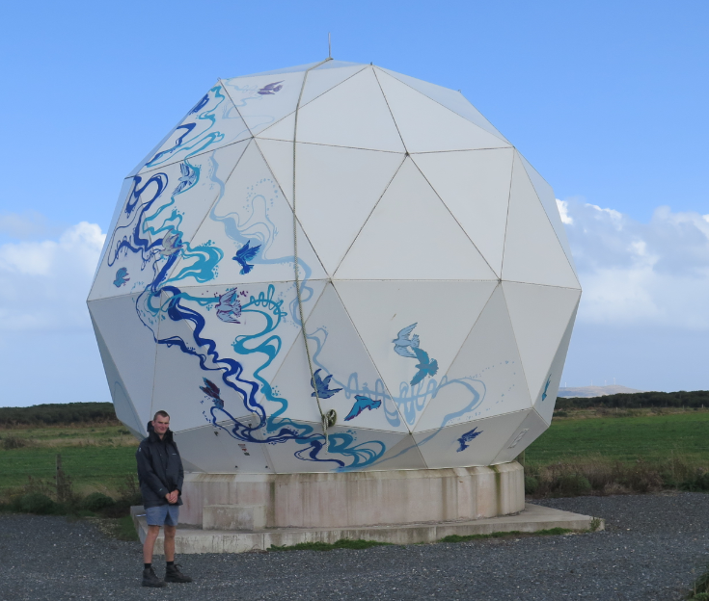
Planet radome protected 5m dish antenna
Radome dimensions
Height: 7.18 m
Diameter: 7.75 m

Slide 4
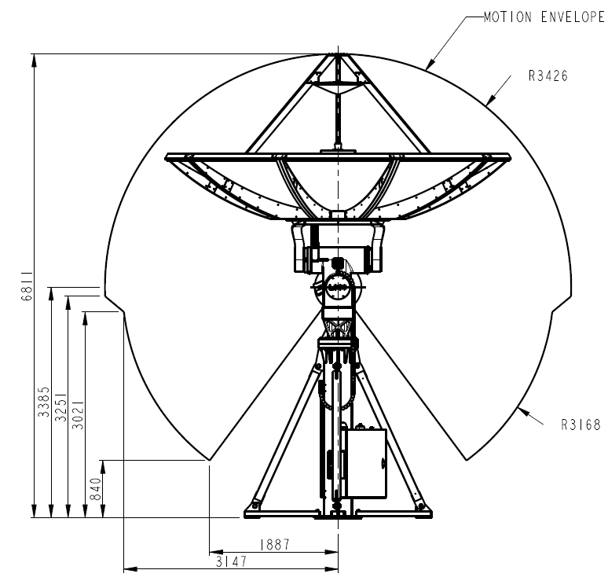
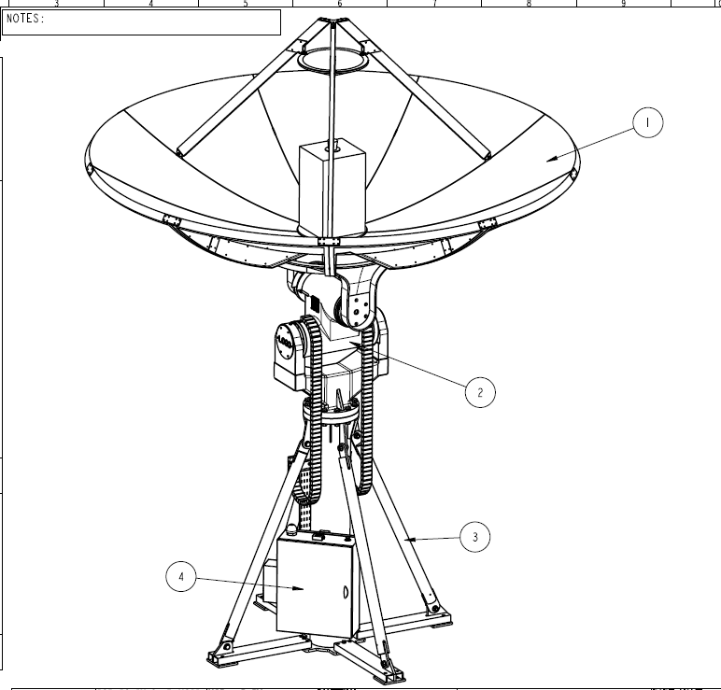
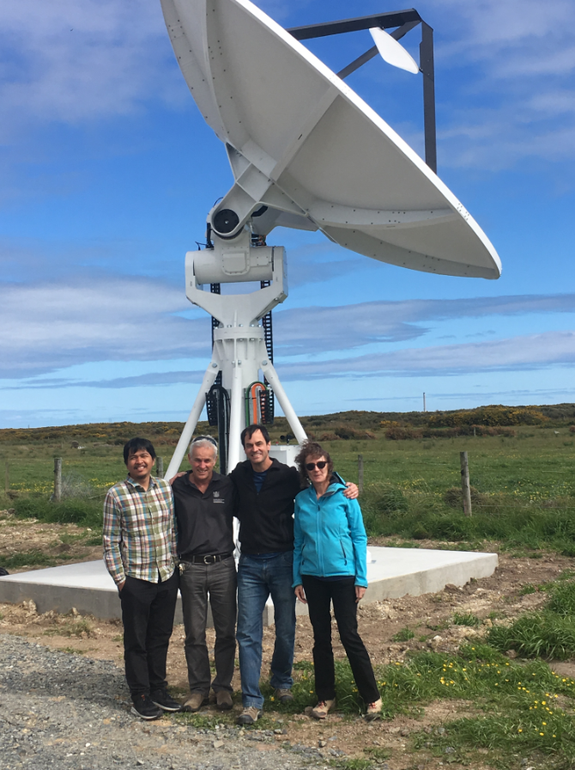
Antenna dimensions
Height to top of stowed dish: 5 m
Diameter: 5 m
SpaceX 5m dish antenna

Slide 5
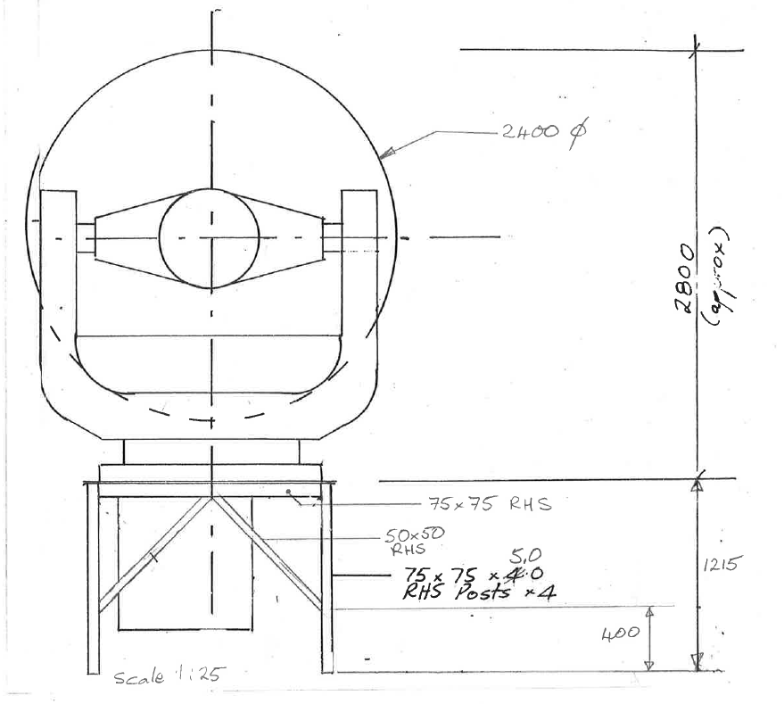
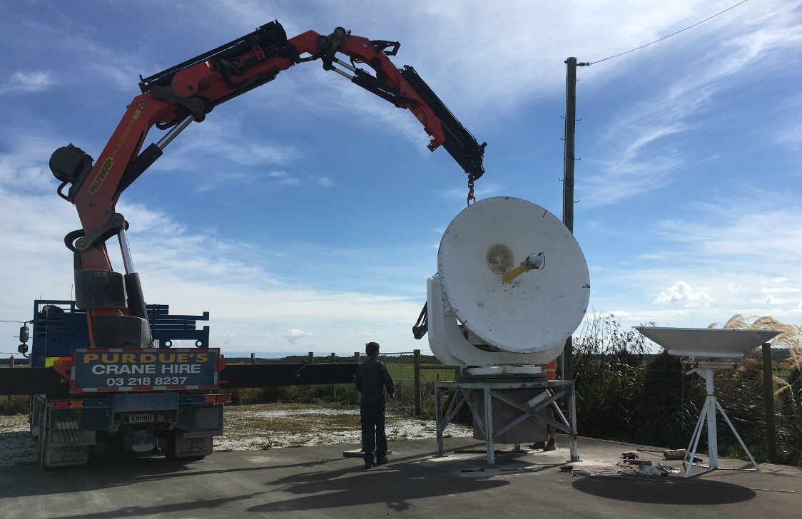
Antenna dimensions
Height to top of stowed dish: 3.4 m
Diameter: 2.4 m
Venture Southland 2.4 m and 1.9m dish antennas

Slide 6
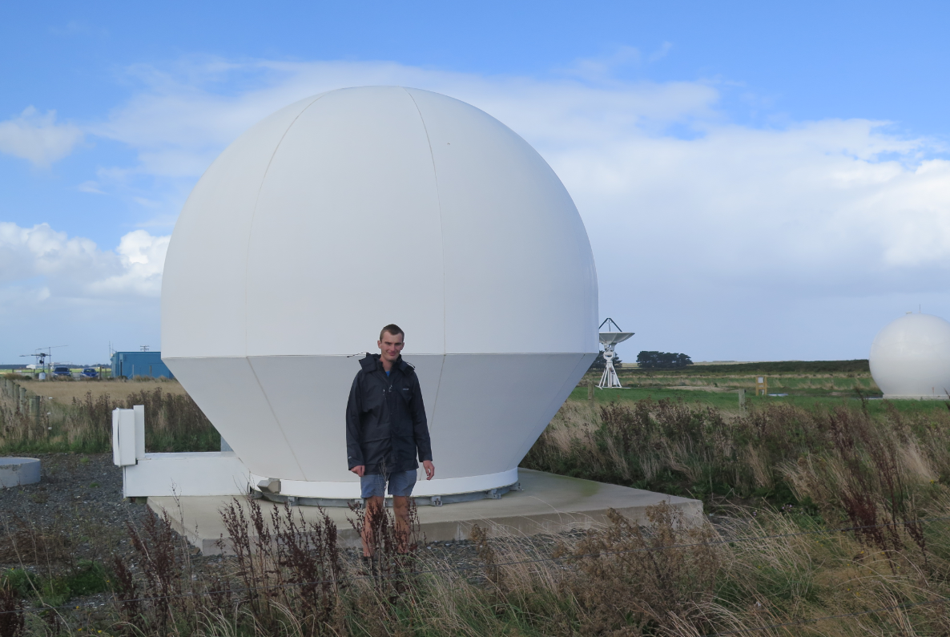
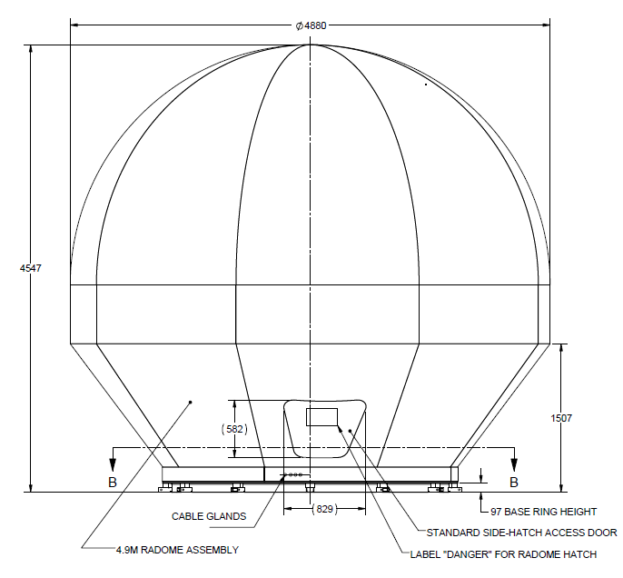
Radome dimensions
Height: 4.87 m
Diameter: 4.88 m
SpaceFlight radome protected 3.7m dish antenna

Slide 7
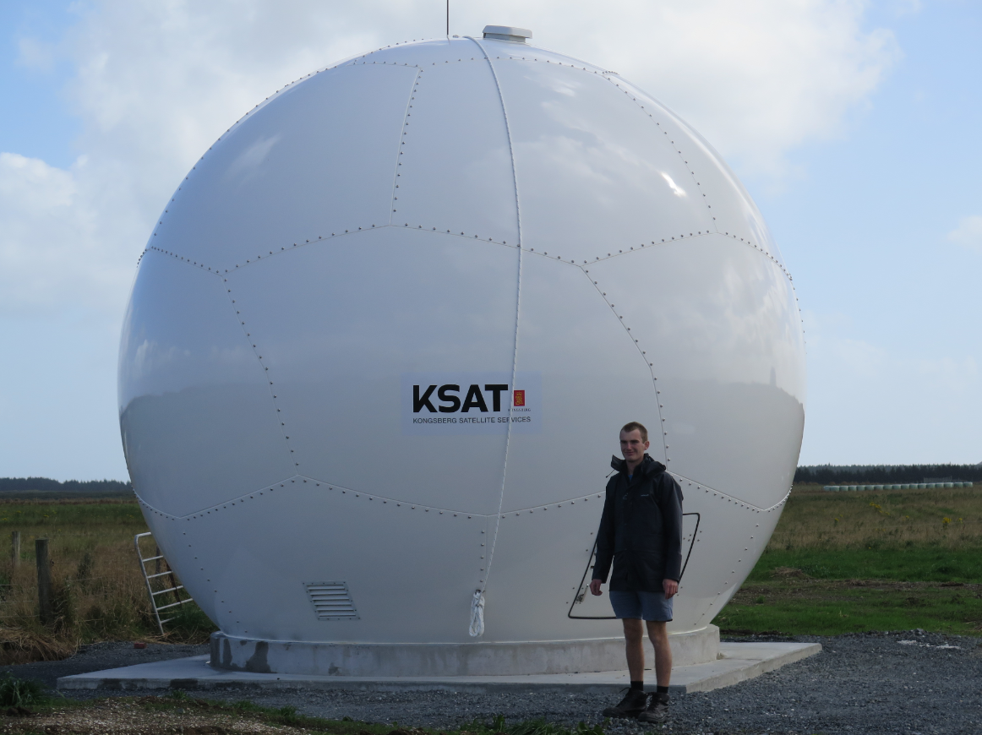
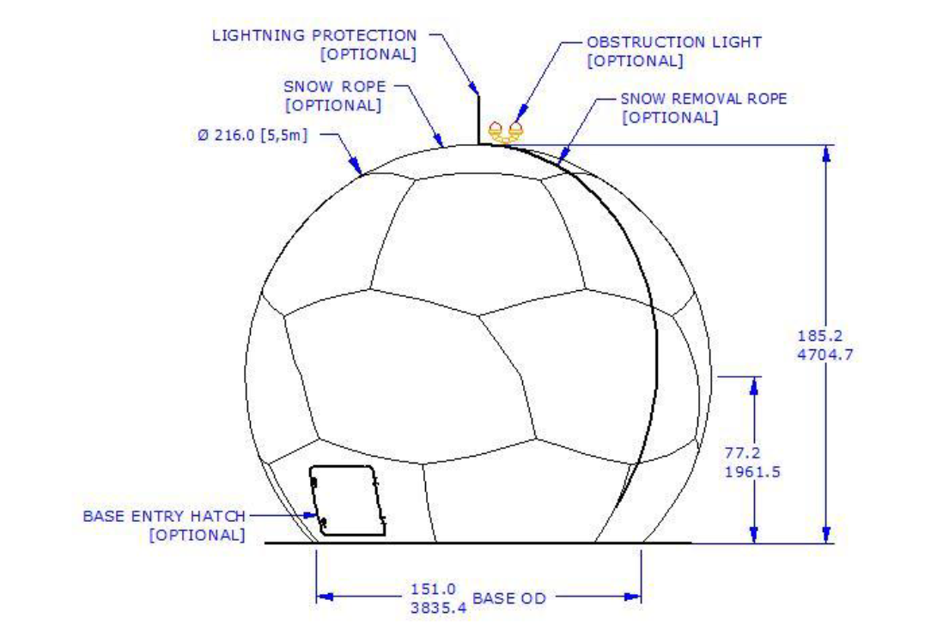
Radome dimensions
Height: 4.80 m
Diameter: 5.50 m
Ksat radome protected 3.4m dish antenna

Slide 8
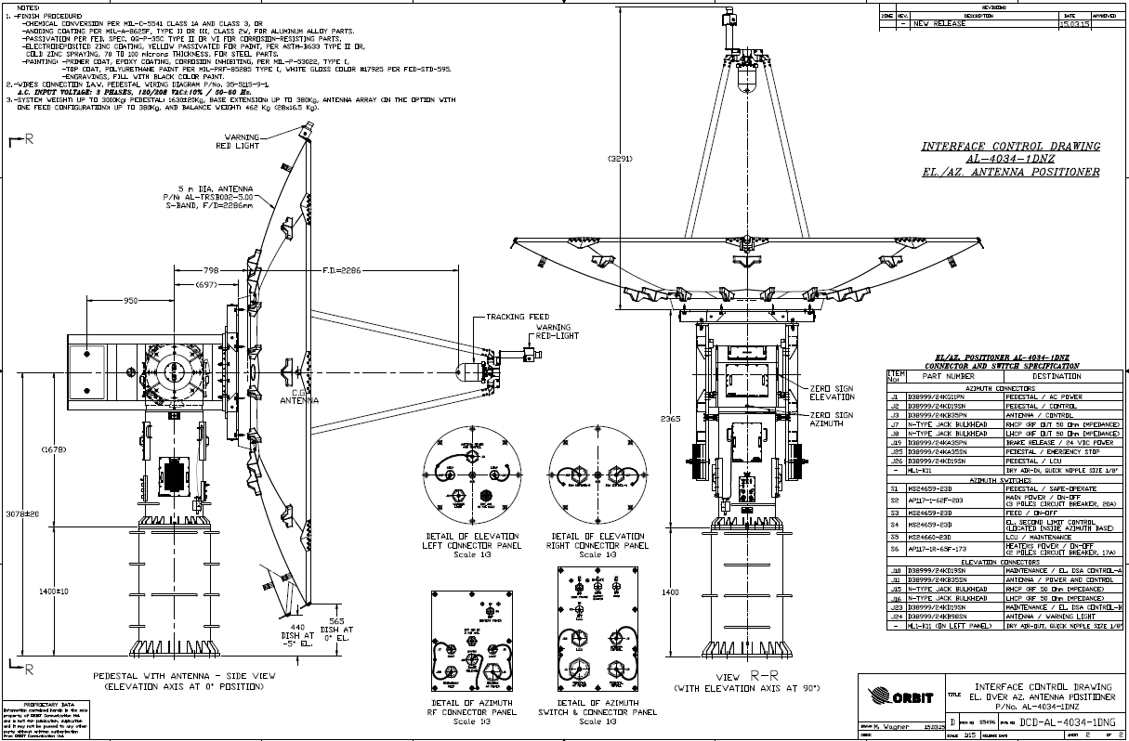
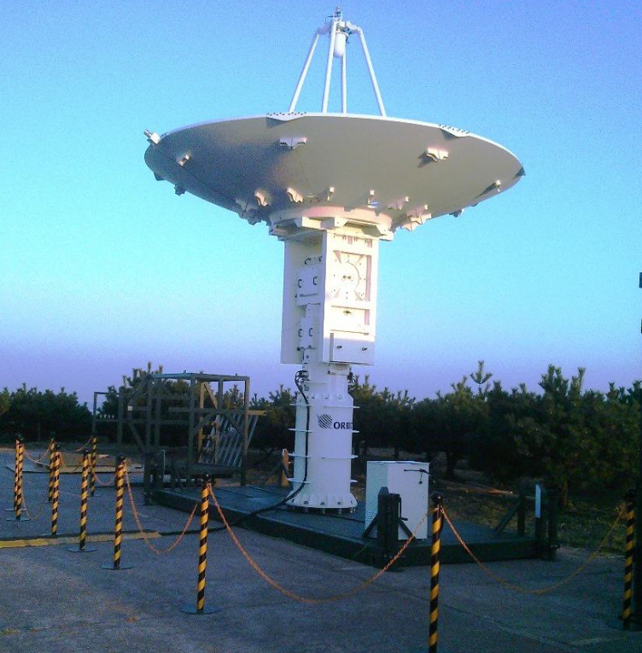
Antenna dimensions
Height to top of stowed dish: 4.7 m
Diameter: 5 m
Proposed 5m Rocketlab antenna

